Slide 1

STEM for Development
Introduction to Statistics & Data Science
Capstone Project: Environmental Awareness & Carbon Footprint Analysis.
Members — Group #2:
Lia Tamara Cedeño Zambrano
Khadija Khatoon
Maryam Hampaei
Ofei Harriet Koryo
Instructors:
Charles Opondo
Ruchir Raman
Habibah Tijani

Slide 2
To what extent do household lifestyle and environmental practices influence carbon footprint levels?
Global warming leading to Climate change is real. While industrial activities and government policies are often highlighted as the main culprits of these excessive carbon emissions into the environment, we cannot ignore the impact created by our household lifestyles and environmental practices. The purpose of this study is to examine how household lifestyle and their environmental practices affect carbon footprint levels. For this, a dataset with 2000 observations containing diverse variables was analyzed, including household energy use, trash management, transportation decisions and lifestyle choices, among others. The crucial insights gathered from this research will assist us in determining which activities ought to be given priority because of their detrimental effects on the state of the global climate. Additionally, this study can help policymakers and environmental organizations develop methods to raise awareness and encourage sustainable living.

Slide 3
To what extent do household lifestyle and environmental practices influence carbon footprint levels?
This dataset captures household level environmental behaviors and carbon emissions in 2000 observations. There are twelve variables in the dataset, with four being categorical and seven being numerical.
Categorical Variables
Numerical Variables
Household_Id
Income_Level
Waste_Recycling
High_Emissions
Household_Size
Electricity_Usage
Gas_Usage
Plastic_Consumption
Public_Transport_Usage
Distance_to_Work
Carbon_Footprint
Environmental_Awareness_Score

Slide 4
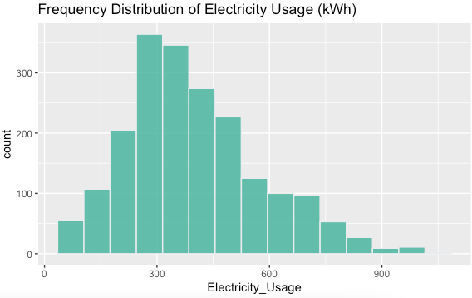
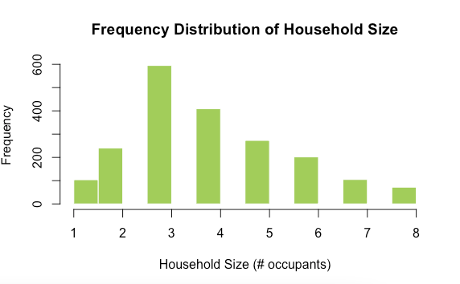
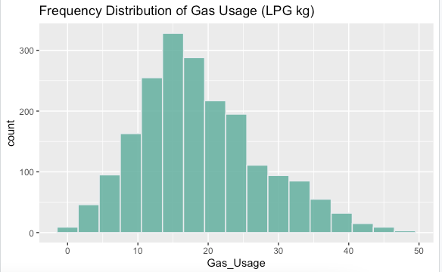
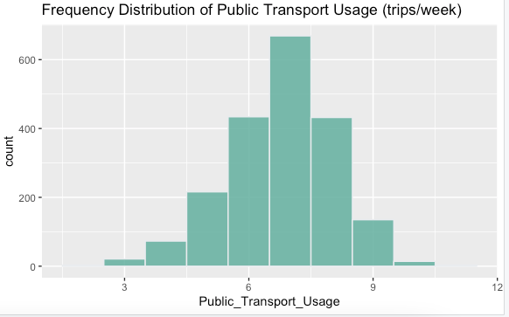
Descriptive Statistics Results – Variables having Normal Distribution but slightly Skewed Right
Mean – 396 Median – 370 SD - 179
Mean – 3.9 Median 4 SD – 1.6
Electricity Usage
Household Size
Mean – 18.8 Median – 17.6 SD – 8.6
Mean – 6.8 Median – 6.9 SD – 1.28
Gas Usage
Public Transport
Slightly skewed left

Slide 5
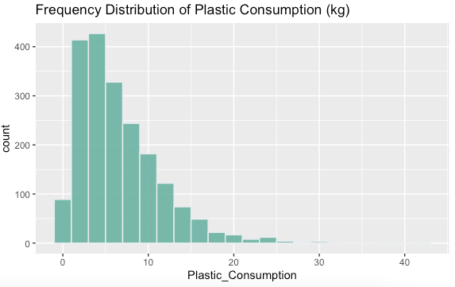
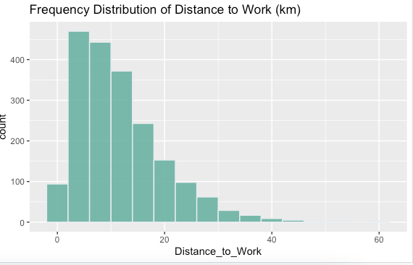
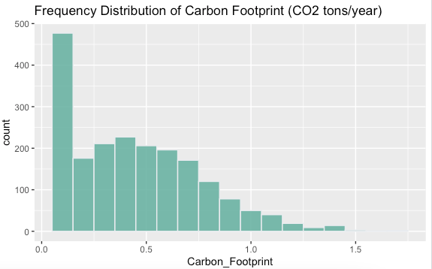
Descriptive Statistics Results – Variables having Normal Distribution but Heavily Skewed Right + Does not comply with Normality, checked via Q-Q
Mean – 6.6 Median – 5.4 SD – 4.89
Mean – 11.7 Median – 10 SD - 8
Plastic Consumption
Distance to Work
Mean – 0.45 Median – 0.40 SD – 0.30
Carbon Footprint

Slide 6
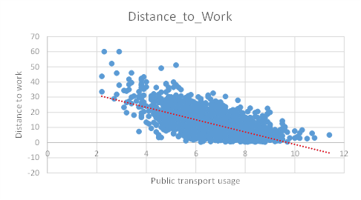
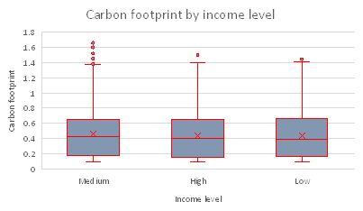
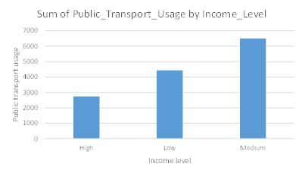
Descriptive Statistics Results – Visualizations
Distance_to_Work against Public_Transport_Usage (Scatter Plot)
Negative correlation
Carbon footprint by income level (Box Plot)
Sum of Public Transport Usage by Income Level (Bar Chart)

Slide 7
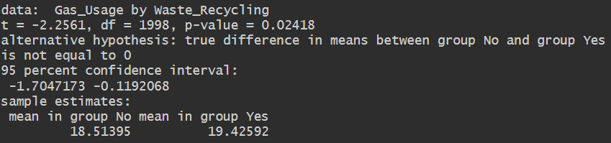
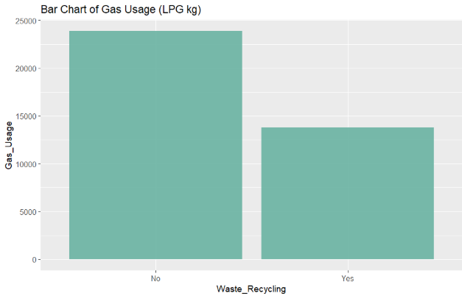
Inferential testing : Parametric tests - Two-sample t-Test
Research Question: Is there a significant difference in the Gas Usage (LPG kg) between the people who recycle and the people who don't?
With a p-value 0.02418, we reject H0.
The Gas Usage (LPG kg) between people who recycle and people who don't is significantly different.

Slide 8
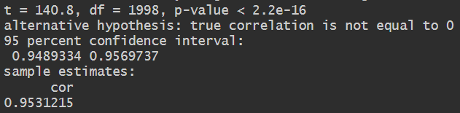
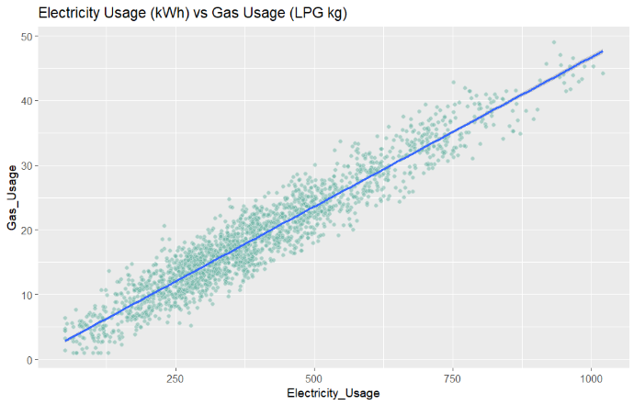
Inferential testing : Parametric tests - Correlation Test
Research Question: Is there a significant correlation between Electricity Usage (kWh) and the Gas Usage (LPG kg)?
With a p-value < 2.2e-16, we reject H0.
There is a significant positive correlation. As the Electricity Usage increases, the Gas Usage increases as well.

Slide 9

Inferential testing : Non-parametric tests- Chi-square test
Research Question: Is there a relationship between Waste Recycling (i.e. if someone recycles waste or not) and Income Level?
If we also do a Chi-Squared test comparing the relationship between the Environmental Awareness Score and Income level, we also get a p = 2.2e-16, further suggesting a socioeconomic factor coming into play.
H0: The proportion of people who recycle waste is not significantly different regarding their income level.
H1: The proportion of people who recycle waste is significantly different regarding their income level.
Since p = 2.2e-16, we reject H0.

Slide 10
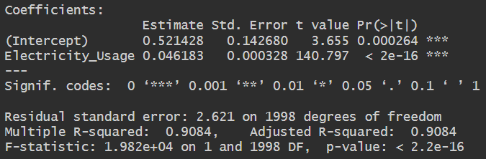

Regression Models & Interpretation - Simple Linear Regression
Plotting Linear Regression model of Electricity Usage (X) with Gas Usage (Y) to figure relation between them.
$$y = m\left(x\right)+ b→ y = 0.046183\left(x\right) + 0.521428$$
With an $R^{2}$ of 0.9084, we can affirm that 90.84% of the data variation in Gas Usage is explained by the Electricity Usage. By taking the square root, we obtain that the correlation coefficient ($R$) is 0.9531, making it a very strong positive correlation.

Slide 11
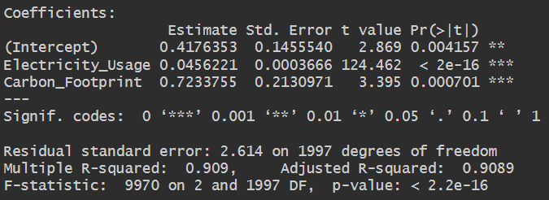
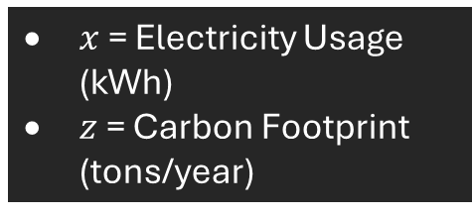

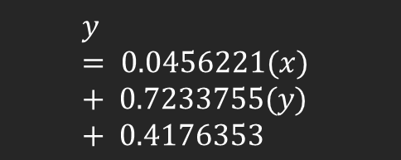

Regression Models & Interpretation - Multiple Linear Regression
Plotting Multiple Linear Regression model of Electricity Usage with Carbon Footprint to figure relation between them.
$$y = m_{1}\left(x\right)+ m_{2}\left(z\right)+ b$$
$$y = 0.0456221(x) + 0.7233755(y) + 0.4176353$$
$x$ = Electricity Usage (kWh)
$z$ = Carbon Footprint (tons/year)
With an $R^{2}$ of 0.909, we can affirm that 90.9% of the data variation in Gas Usage is explained by the Electricity Usage and the Carbon Footprint. This model is slightly better than the Single Linear Regression one, although not by much.

Slide 12
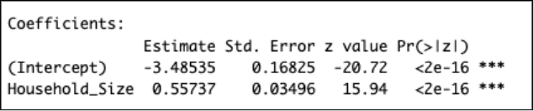
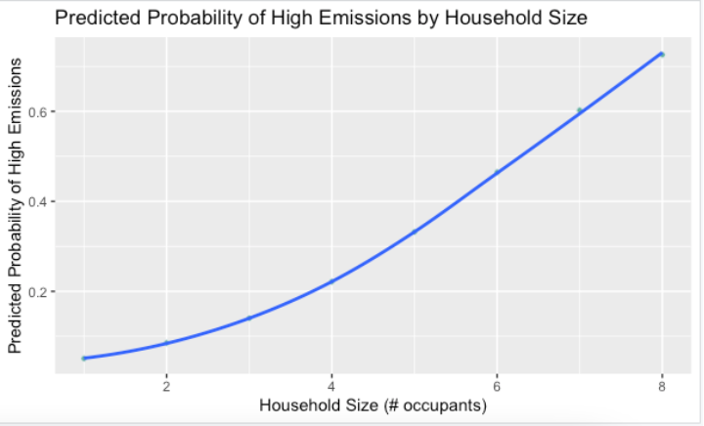
Logistic Regression
Y = High emissions as Outcome (dependent variable) X = Household size as predictor (independent variable)
Plotting Logistic Regression model using High emissions against Household size
Exponentiating: Household_size - exp(0.55737) = 1.746074
Intercept - exp(-3.48535) = 0.03064303
Household size has a significant effect with p-value being 2e-16.
This means as number of household members increases, the probability of being a high emitter increases too. The linear model formula is as follows:
y = 0.03064303 + 1.746074(x)
This is a statistically significant result, which predicts the odds of larger households being a high emitters, as seen on the graph.

Slide 13
Insights: What factors affect Carbon Footprint the most?
Gas usage has a strong positive correlation with Electricity Usage. This indicates that households that use more electricity, on average, also use more gas, leading to a larger carbon footprint.
Certain middle-income households have a large carbon footprint when compared to different income households. While income alone may not strongly predict a household’s carbon footprint, it appears that middle-income households are more likely to have upper outliers due to external, unknown factors.
Public transport is used the most by medium-income households followed by low-income households and then by high-income households. This indicates that high-income households may own personal means of transport.
There's a sociopolitical factor at play when it comes to whether a household recycles waste or not. Higher income/class households recycle more and don't have as much emissions as those from lower income/class, suggesting a possible educational angle as well.
For every added occupant in a household, the chances of becoming high emitters increase 1.74 times, or 74%. This also indicates that larger households, on average, have higher carbon footprints.

Slide 14
Recommendations: Practical solutions for reducing household emissions
Both public and private transport should be optimized as much as possible. Ideally, government initiatives should strive to improve public transport accessibility and quality, so people are more likely to use it. As for private transport, educational campaigns should be enacted, to teach people to optimize and plan trips to reduce gas emissions (e.g. plan and schedule grocery shopping instead of it being last minute, coordinate with friends to go in the same car to a destination, etc.).
Large households should invest in smart, eco-friendly appliances that can reduce their carbon footprint, which is elevated by its number of occupants. If feasible, they should invest in renewable energies as well, such as solar panels, for example.
Educational campaigns and recycling initiatives should be enacted at large by the government to encourage households to recycle and learn how to do it. A great example of this is Germany’s Deposit Refund System (https://earth.org/wastemanagement-germany/), which reimburses money to people when they recycle.

Slide 15
For further research, we recommend the following:
The study can be expanded with further socioeconomic variables. In the insights we mentioned that higher income households recycle more and don't have as much emissions compared to lower income households. However, this insight should be tested with other factors related to income level. For example, would this insight hold up if we consider the amount of commercial airplane trips —which are high CO2 emitters— a household has in a year? How many airplane trips do these different income level households have in a year? Are they required by work or are they recreational trips?
Further regression models should be created to determine whether the variables have non-linear relationships between them. We tested for correlation other variables in the dataset and some rejected H0 but did not have a good linear model fit. As we learn more about statistics, we’ll be able to create a model that better fits these relationships.

Slide 16
QUESTIONS

